Slide 1






TRASH HUNTER
Submarine Edition
START

Slide 2
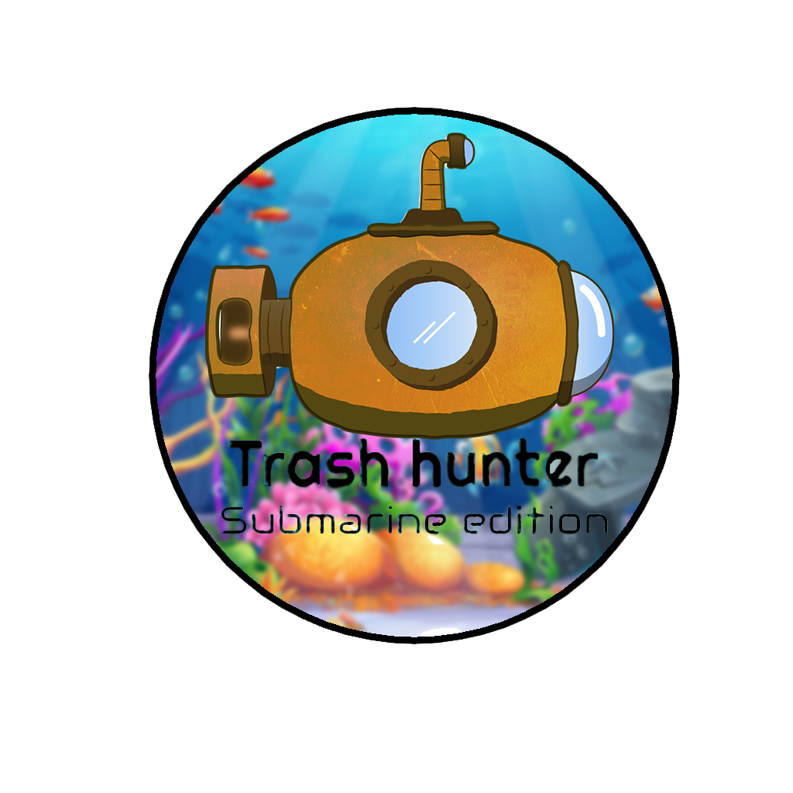


Name of the Game: Trash Hunter – Submarine Edition
Module Name: Computer Game Programming
Module Code: MULT2120C
Assignment Title: Physics game that promotes SDGs
Link to our Assets Repositories and License:
https://github.com/stuartjeet122/gaming-assets-2
Link to our Download our Game:
Link to Play our Game Online:

Slide 3








STAKEHOLDERS
Kheertik Jeetun
2110_22804
Moodita Jankoo
2110_22801
Deepvesh Hurjoon
2110_22797
Stuart Wayne
2110_22803
Fabrice Manikon
2110_22814

Slide 4



ACKNOWLEDGEMENT
We extend our heartfelt gratitude to everyone who contributed to the success of "Trash Hunter: Submarine Edition" and the associated gaming report. Your dedication and teamwork were instrumental in shaping both the game and the analysis, creating a collaborative project.
Special thanks to our team members for their unique contributions and commitment. Your collaborative spirit enriched the gaming experience and ensured the project's success.
We express our deep appreciation to our mentor, Mr. Riyad Dhuny, for invaluable guidance throughout the journey.
To our friends and family, thank you for your unwavering support and encouragement. Your contributions have made "Trash Hunter: Submarine Edition" a success.
Sincerely,
Jeetun Kheertik
Jeetoo Stuart
Hurjoon Deepvesh
Manikon Fabrice
Jankoo Moodita

Slide 5




ABOUT OUR GAME

Slide 6
GAME STORY
In the immersive game "Trash Hunter: Submarine Edition," players take on the role of courageous ocean explorers on a mission to clean the ocean from trash. Equipped with a state-of-the-art submarine, players dive into the deep blue sea, navigating treacherous underwater landscapes to capture and remove debris. As they collect trash, players learn about the devastating impact of pollution on marine life and the urgent need for ocean conservation. With each successful retrieval, players unlock educational facts and tips on waste reduction, inspiring them to take real-life action. Together, we can save the ocean and protect its delicate ecosystem for generations to come.

Slide 7

PROJECT BRIEF
Trash Hunter: Submarine Edition is an immersive gaming experience crafted to elevate awareness of ocean pollution and instill sustainable behavior in players. The game unfolds with Abyssal Ranger (The Submarine) as the central character, leading a Trash Hunt. As the submarine navigates through polluted underwater landscapes, it will discover the consequences of neglect and the importance of responsible waste management, recycling, and ocean conservation.

Slide 8
GAME PLOT
In the not-so-distant future, the world's oceans are drowning in pollution, and marine life is on the brink of extinction. Governments and environmental organizations have come together to form the Oceanic Cleanup Initiative, deploying advanced submarines equipped with cutting-edge technology to combat the rising tide of trash. As an elite member of the Trash Hunter squadron, you are tasked with piloting the most advanced submarine, the "Abyssal Ranger," to explore the darkest depths of the ocean and clean up the mess humanity has left behind.

Slide 9
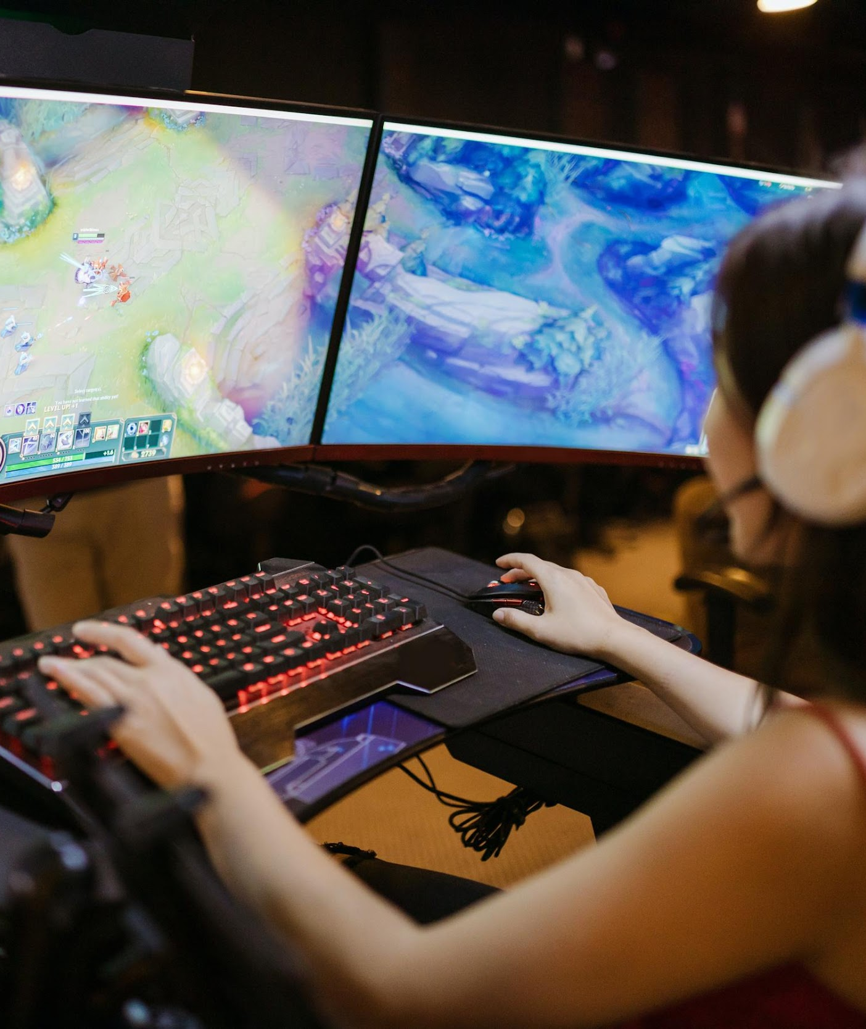

About the Game
"Trash Hunter: Submarine Edition" combines immersive gameplay with environmental education. As Submarine, players navigate ocean depths, collecting trash and overcoming obstacles. The game seamlessly integrates garbage collection and recycling themes, using unique in-game currencies to teach players about environmental sustainability. The choices made in the game impact both the storyline and the virtual ocean environment, encouraging players to adopt more sustainable behaviors. Ultimately, the game provides an engaging experience that inspires real-world actions for a cleaner, healthier ocean ecosystem.

Slide 10


Why This Idea?
Core Audience
Games like "Trash Hunter: Submarine Edition" fall within the serious games genre, aiming to influence behavior rather than solely entertain. This form of gameplay serves as a tool for promoting social change, conducting research, facilitating education, and enabling scientific discovery. By emphasizing ecology, such games can delve into the economic, humanitarian, and societal dimensions of environmentalism, offering a holistic exploration of the challenges and opportunities in fostering environmental awareness and sustainability.
"Trash Hunter: Submarine Edition" is designed to capture a broad audience, especially those with an interest in environmental sustainability and awareness. With its focus on garbage management and recycling, paired with interactive and captivating gameplay, "Trash Hunter: Submarine Edition" appeals to both children and adults. The game not only entertains but also serves as an educational tool, imparting valuable lessons about the importance of environmental sustainability and the consequences of pollution.
Target Audience:
Age Group: 7 – 15 years old
Gender: Male & Female

Slide 11


LEVELS
&
BACKGROUNDS

Slide 12

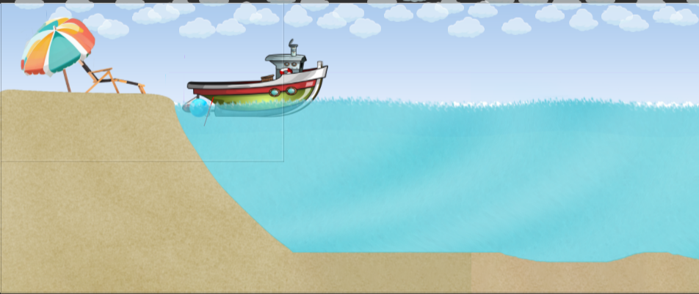
LEVEL 1
It immerses players in a serene and picturesque beach setting. The simple yet captivating background features golden sands stretching along the shoreline, meeting the tranquil, azure sea and sky. The rhythmic ebb and flow of gentle waves create a soothing atmosphere, enhancing the overall gaming experience.

Slide 13
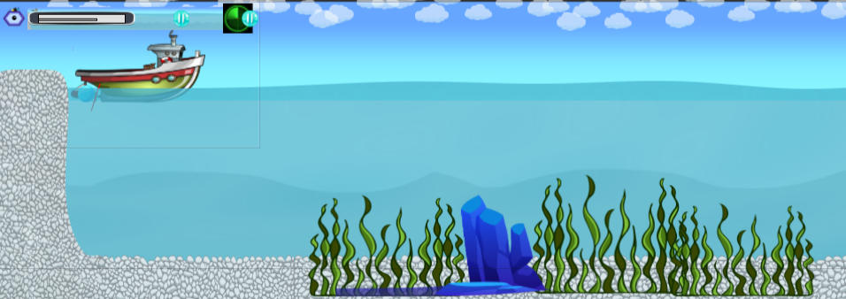
LEVEL 2
The oceanic backdrop continues to captivate players, but this time with a distinctive twist. The familiar sea serves as the canvas, adorned with a rugged landscape of rocks, vibrant algae, and scattered stones. This new environment introduces an added layer of challenge as these natural elements become obstacles in the cleanup mission.

Slide 14
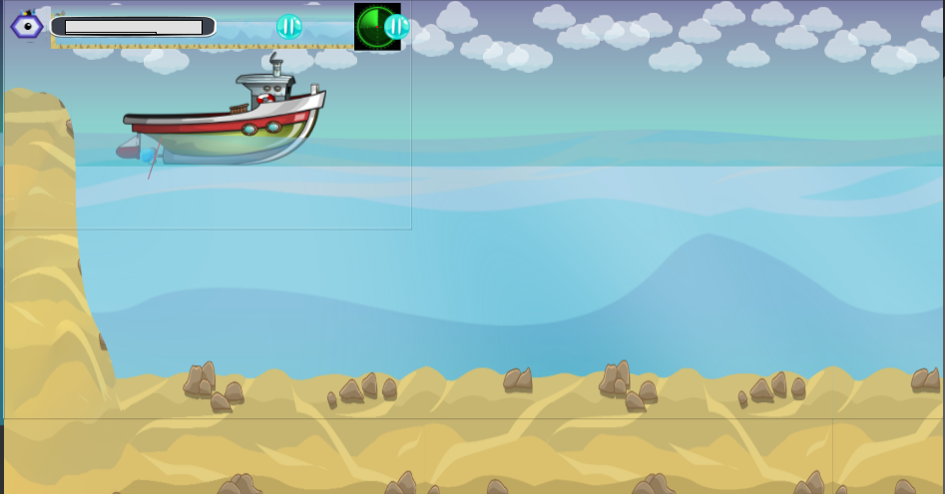
LEVEL 3
It presents a familiar yet subtly transformed seascape. The serene sea background retains its calming allure, this time complemented by the presence of soft, sandy expanses interspersed with scattered rocks. The combination of sand and rocks introduces a nuanced variation to the underwater environment.

Slide 15
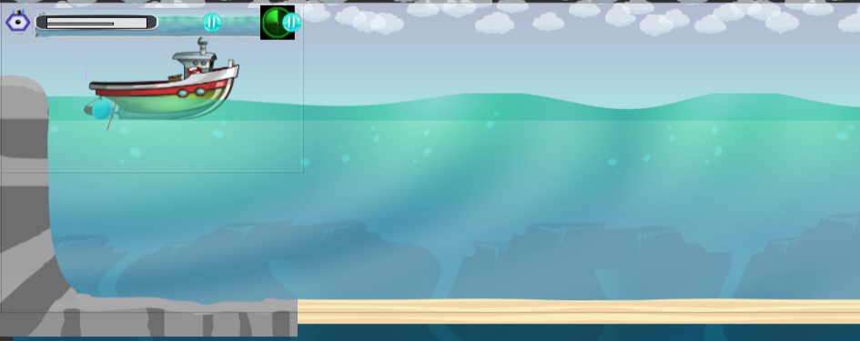
LEVEL 4
It takes players to the depths of the ocean, presenting a vast and expansive backdrop characterized by the mysteries of the deep sea. The serene blue expanse extends into the distance, creating an immersive environment that signifies a shift into deeper waters.

Slide 16
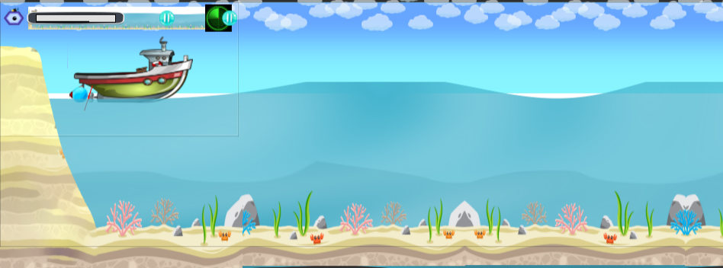
LEVEL 5
The players are treated to a vibrant and lively underwater spectacle. The sea background comes to life with an explosion of colors, showcasing a diverse array of marine life, and vibrant seaweeds that sway with the gentle currents. This level offers a visually stimulating and dynamic environment, a stark contrast to the simplicity of earlier levels.

Slide 17
GAME ASSIGNMENTS
&
BEHAVIORS

Slide 18


Game Assignment
Kheertik
Deepvesh
Spawn objects randomly
Submarine Modification + Backend
Stuart
Fabrice
Submarine Movement
Single Sign On
AdMOB
Jhanvy
Start Screen + Backend

Slide 19
Behaviors
Physics
Platformer
Sine
Solid
Pin
Fade
Line of Site
Scroll To

Slide 20
GAME CHARACTERS

Slide 21


SUBMARINE
Abyssal Ranger
The Submarine is a whimsical underwater vehicle that is designed to collect a certain amount of trash and deliver them to the boat. It is powered by a set of brightly colored propellers, and it is adorned with decorative fins and other features that make it stand out in a crowd.

Slide 22

BOAT
The Flying Dutchman
A specialized support boat plays a crucial role in the ocean cleanup operation. Responsible for deploying and retrieving the Abyssal Ranger submarine, the boat facilitates a seamless cycle of waste collection. The submarine is released into the ocean, collects a significant amount of trash, resurfaces, and transfers the debris to the support boat.

Slide 23

CLAW
The Abyssal Ranger submarine employs a specialized claw mechanism located at the front of its sleek design. This state-of-the-art claw serves as the primary tool for efficiently collecting floating debris and trash from the ocean depths.

Slide 24











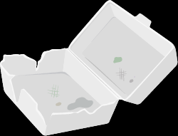








TRASH
The ocean is contaminated with a diverse range of debris, from common litter to hazardous waste, presenting a significant threat to marine life and the delicate underwater ecosystem. Players will face various types of realistic and varied pollutants, such as plastic bottles, discarded containers, and rusting metals, each possessing distinctive characteristics. The visual representation of the trash underscores the gravity of the pollution problem, emphasizing the urgent need for cleanup within the game's narrative.

Slide 25






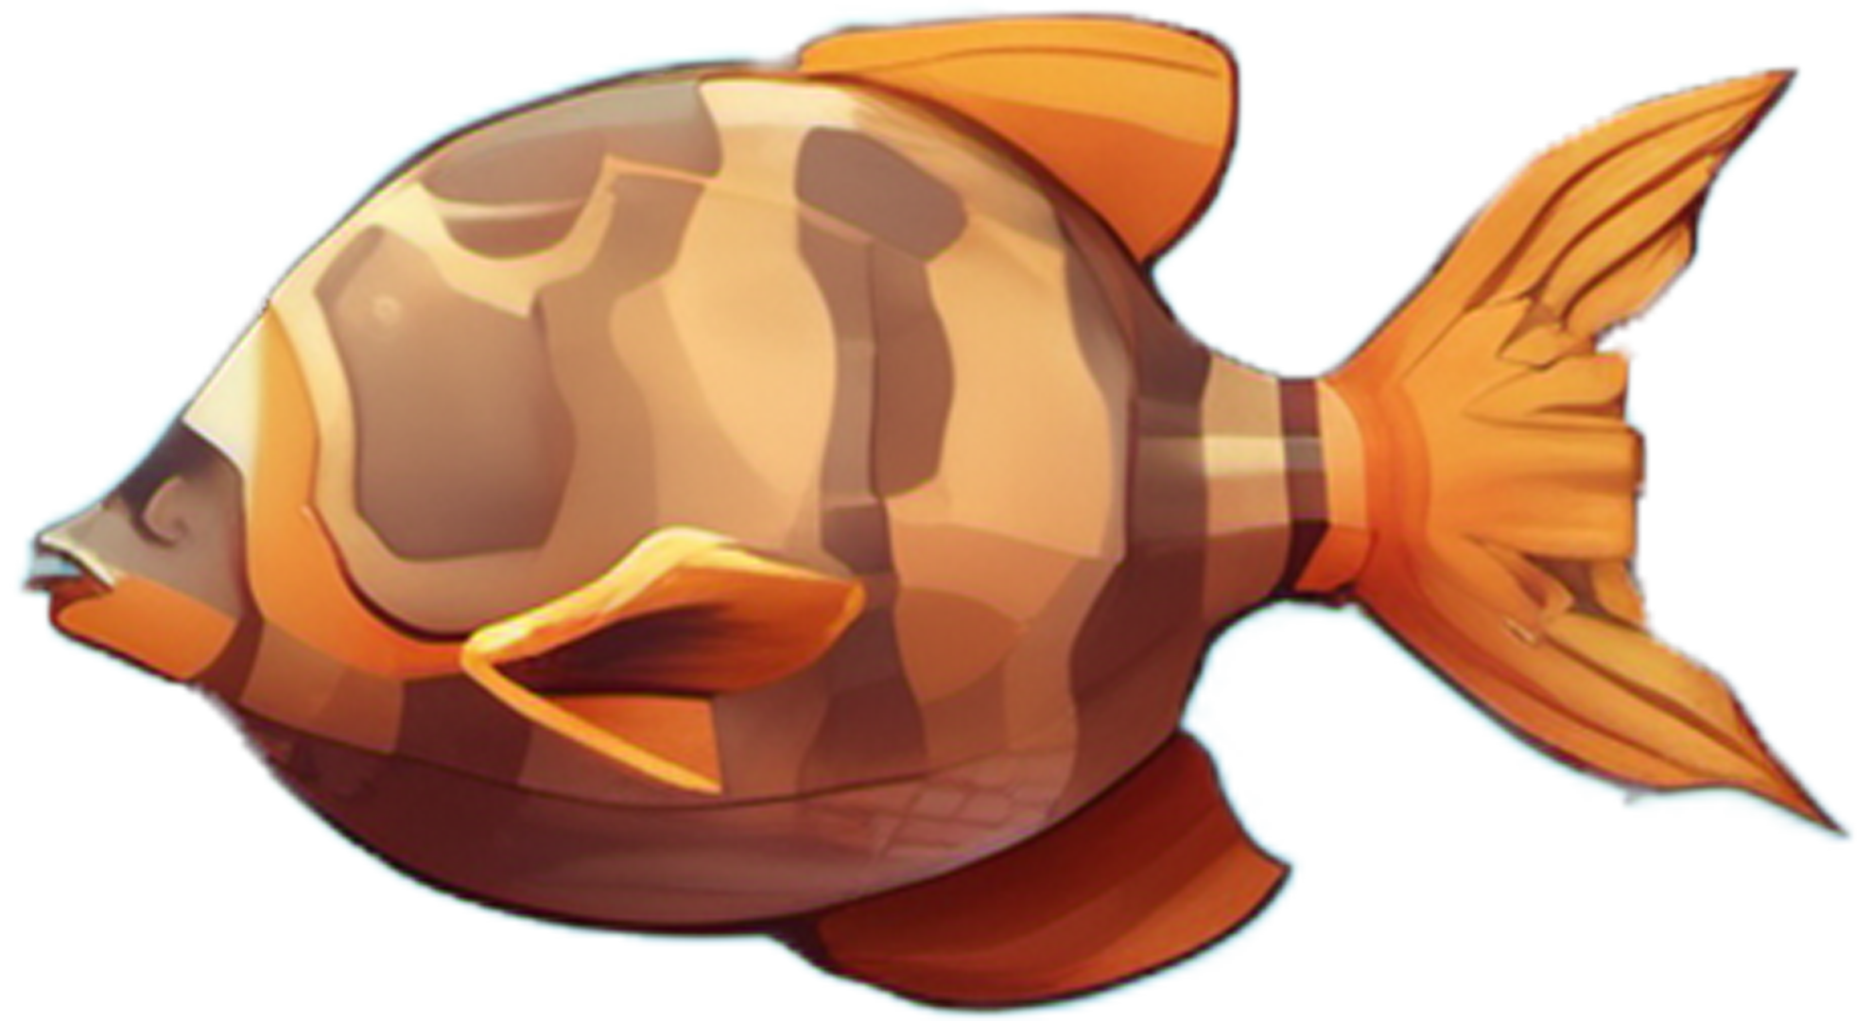





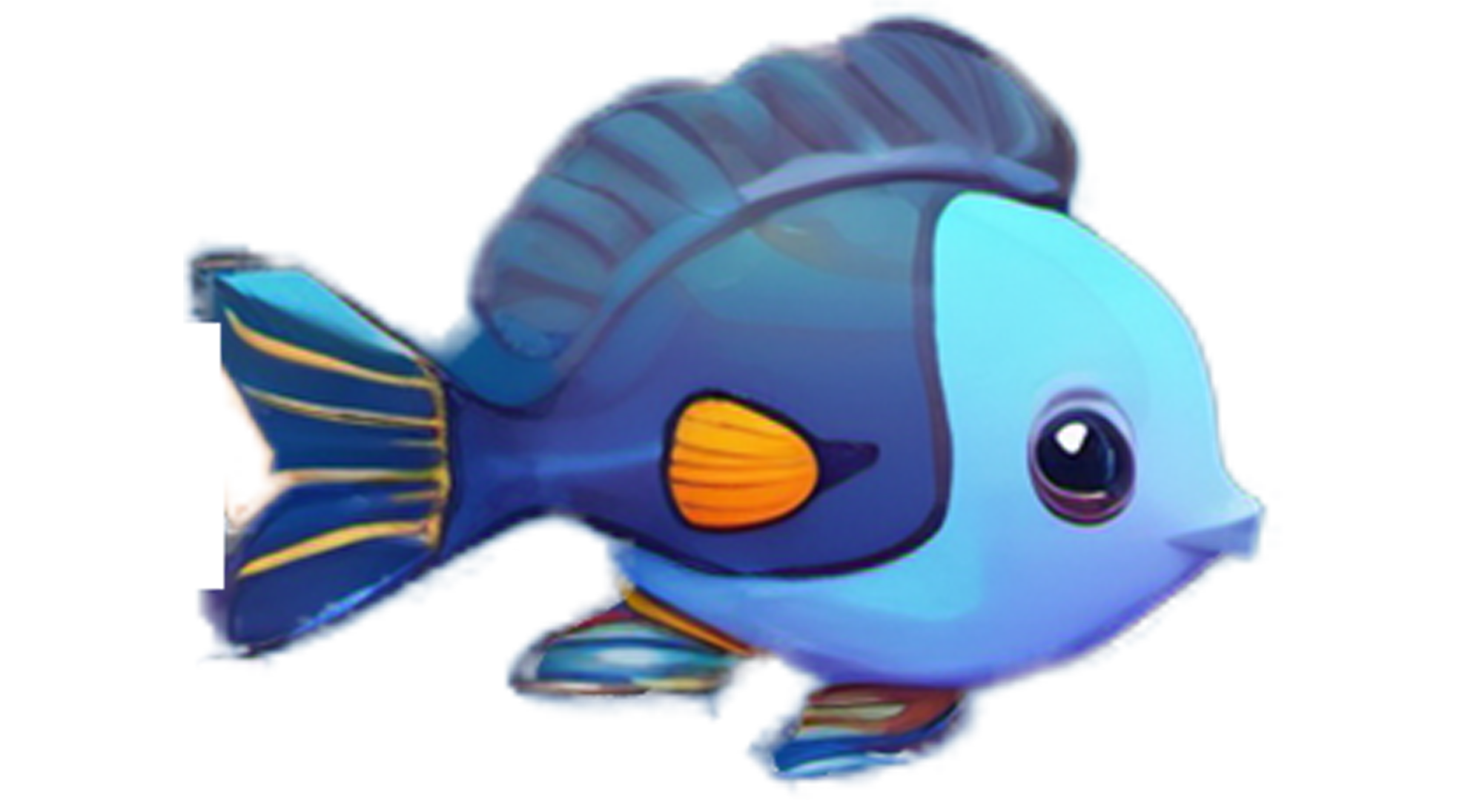
FISH
The inclusion of various fish species serves as a captivating element that enhances the game's visual appeal and realism, creating a more immersive oceanic environment. These digital aquatic inhabitants contribute to the game's overall beauty, bringing the underwater world to life with vibrant colors, intricate animations, and diverse marine behaviors.

Slide 26
GAME OBJECTS

Slide 27
MINIMAP
The minimap emerges as a crucial navigational tool, dynamically revealing the movements and strategic actions of the support boat. This feature not only enhances gameplay but also provides players with real-time insights into the overall mission dynamics.

Slide 28
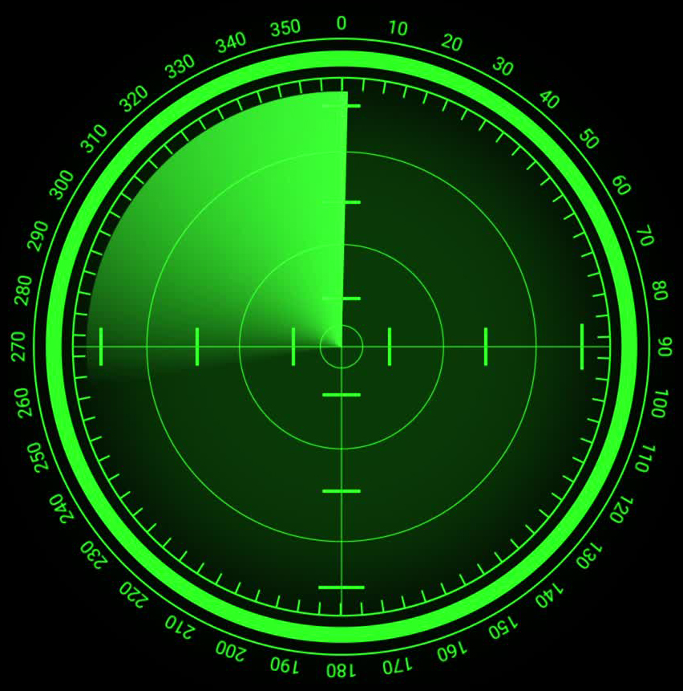
RADAR
The radar system emerges as a pivotal technology, enhancing the gameplay experience by providing players with a comprehensive tracking mechanism for the Abyssal Ranger submarine. This innovative feature contributes to the game's strategic depth and immersive nature, allowing players to navigate the polluted waters with precision and efficiency.

Slide 29
GUI

Slide 30

TRASH SCORE
The score bar stands as a pivotal element, meticulously calculating the total number of trash items collected by the Abyssal Ranger submarine. This dynamic feature not only quantifies the player's impact on the cleanup mission but also transforms the gameplay into a measurable and rewarding experience.

Slide 31
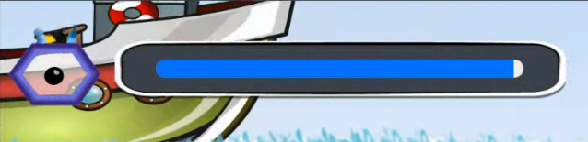
PROGRESS BAR
The inclusion of a progress bar adds a valuable dimension to the gaming experience by providing players with a visual representation of the duration of the game. This dynamic element serves as a guide, offering insights into the overall progress and timeline of the ocean cleanup mission.

Slide 32
OBSTACLES

Slide 33

STONES
The ocean environment is not only teeming with debris but also presents unique challenges in the form of stones and corals. These natural elements add an extra layer of complexity to the gameplay, requiring players to navigate carefully to avoid obstacles.

Slide 34
SOUNDS

Slide 35
SOUNDS USED
Crane Sound
Sonar Sound
Background
Explosion
Underwater Sound
Whale SFX
Waves & Seagull
Bubble SFX
Big Engine Start & Run Off
Motor Boat Sound
The Epic Hero

Slide 36
FEATURES

Slide 37
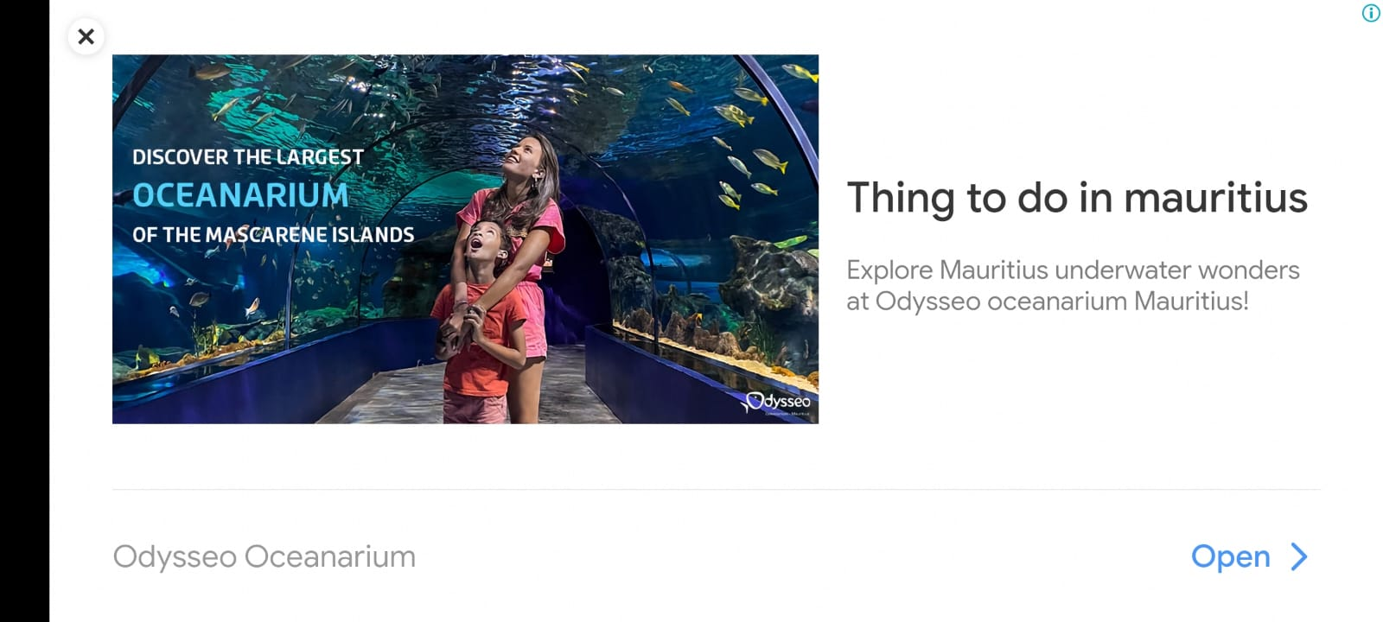
ADMOB
It enhances the gaming experience by introducing non-intrusive advertisements. AdMob seamlessly incorporates ads at strategic points within the game, providing a balanced approach that does not disrupt gameplay while offering opportunities for players to engage with relevant content.

Slide 38
SINGLE SIGN ON
It streamlines the player's experience by providing a seamless and efficient authentication process. With SSO, players can use a single set of credentials to access the game, eliminating the need for multiple logins.

Slide 39
GAME CONTROLS

Slide 40
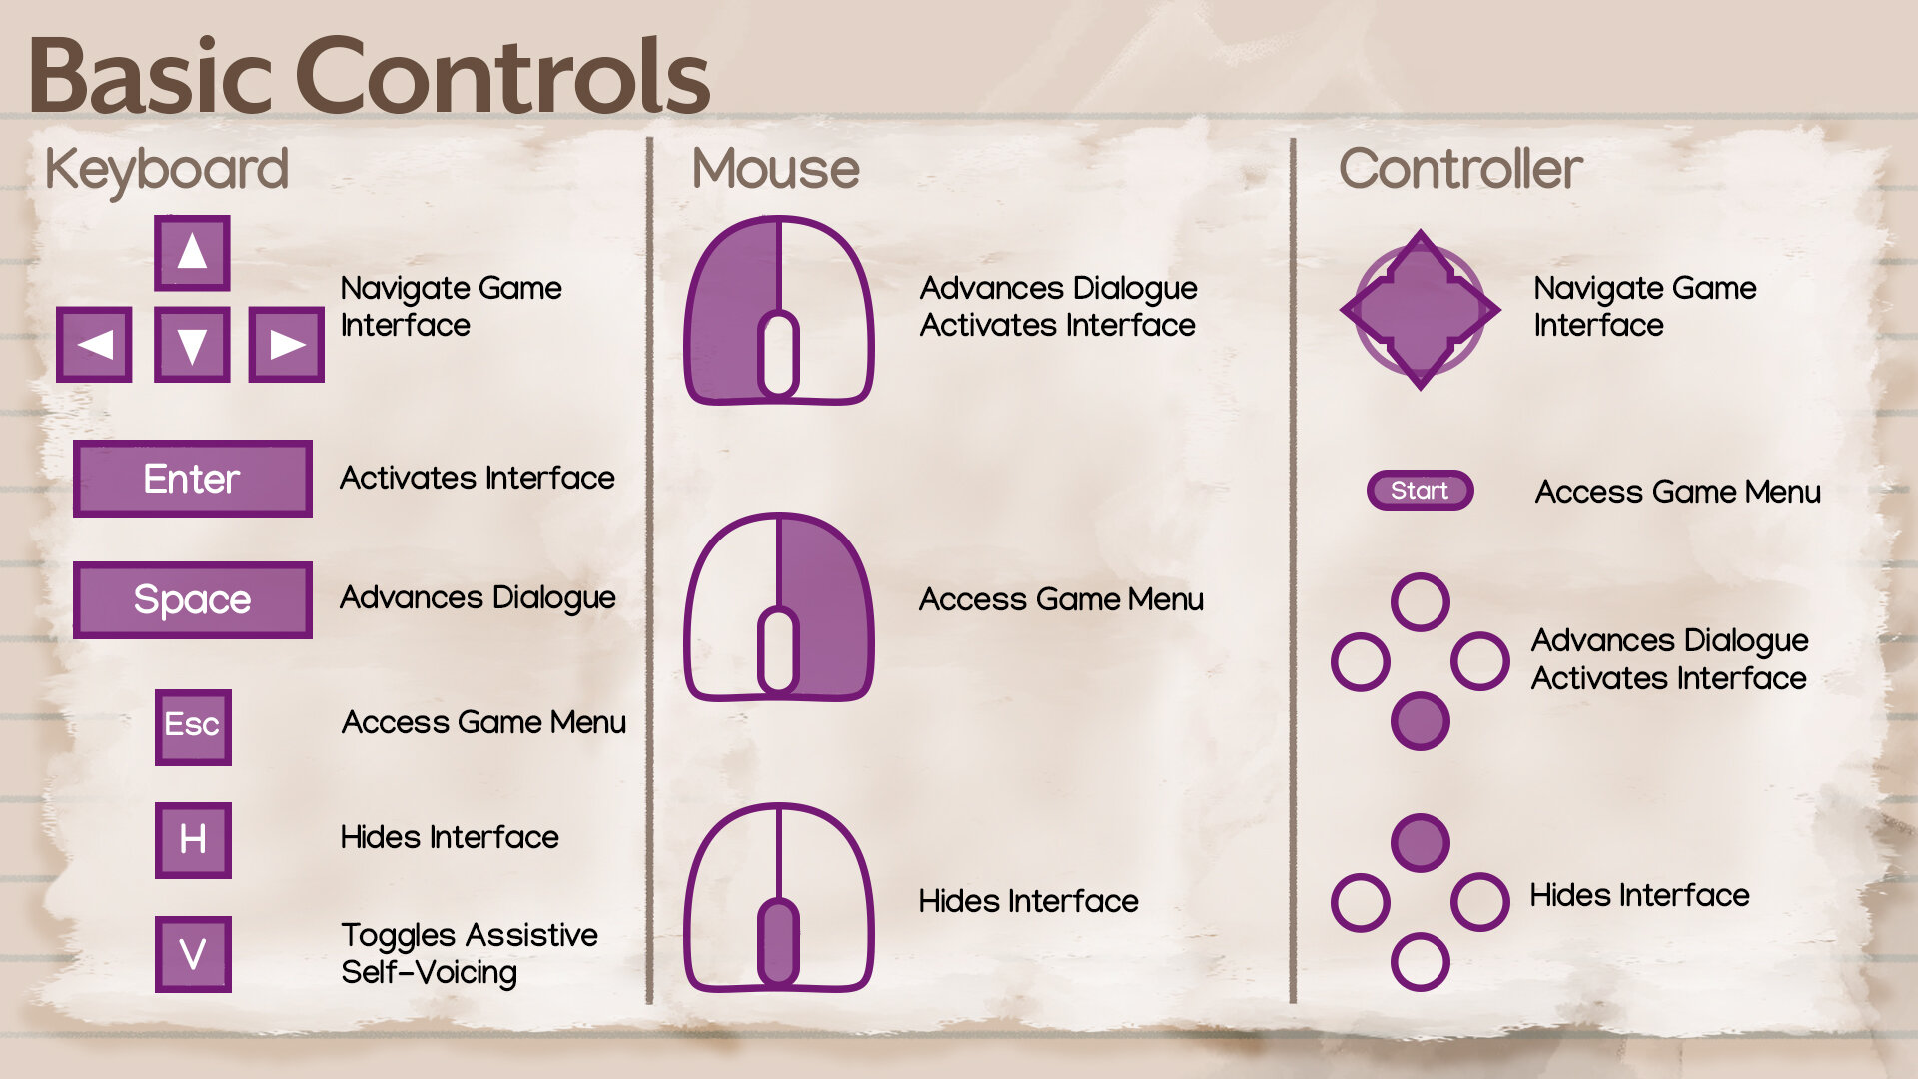
BASIC CONTROLS
In any game, mastering the basic controls is essential for players to navigate and interact seamlessly with the virtual environment. "Trash Hunter: Submarine Edition" is no exception, offering intuitive controls that enhance the gaming experience.

Slide 41


BUTTON CONTROLS
In this underwater adventure, players have straightforward controls to manage the Abyssal Ranger submarine and coordinate with the support boat. The space bar serves a dual purpose, allowing players to both remove and enter the submarine from the boat, ensuring flexibility in movement and strategic decision-making.
When submerged, the arrow keys become the player's navigation tool, providing precise control over the submarine's direction. This allows players to maneuver through the ocean depths with accuracy, avoiding obstacles and efficiently collecting trash.

Slide 42
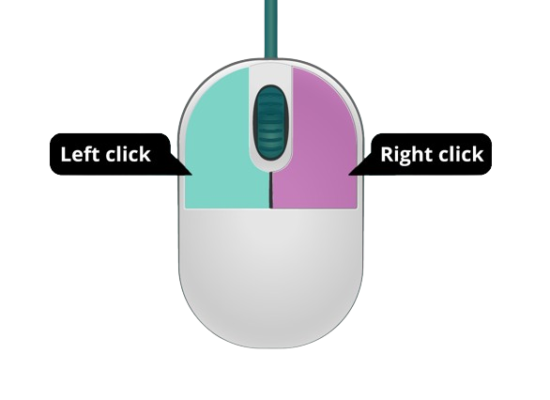
MOUSE CONTROLS
Interacting with the environment is made simple with mouse controls. The right-click releases collected trash into the support boat, contributing to the ongoing cleanup efforts. Conversely, the left-click activates the submarine's claw mechanism, allowing players to skillfully collect debris from the ocean, emphasizing the hands-on approach to pollution control.

Slide 43
BUTTONS

Slide 44




GAMEPLAY BUTTONS
The "Play" button invites players to dive into the underwater adventure, initiating the mission to clean up the ocean.
The "Credits" button provides recognition to contributors and enhances transparency about the game's development.
The "Settings" button allows players to customize their gaming experience, adjusting preferences such as audio, graphics, and controls.
The “Back” button offers players a convenient way to return to the previous screen or menu, enhancing flexibility and ease of interaction during gameplay.

Slide 45
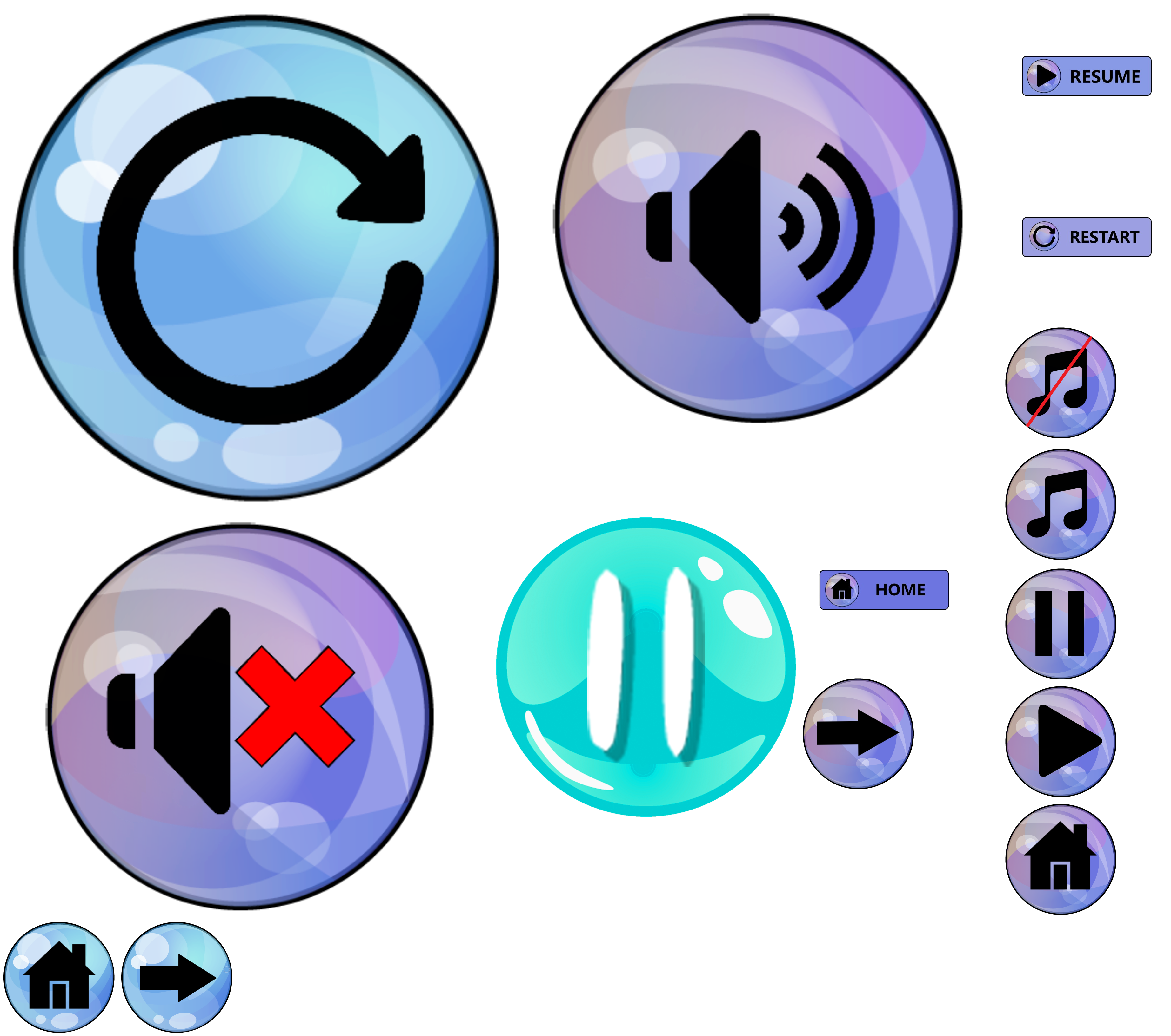
BUTTONS
"Trash Hunter: Submarine Edition" ensures user convenience with essential buttons, including pause for temporary halts, restart for fresh opportunities, settings for customization, and a credit button for acknowledging contributors. These features empower players to control their gaming experience, customize preferences, and explore credits for a comprehensive and user-friendly gameplay session.

Slide 46
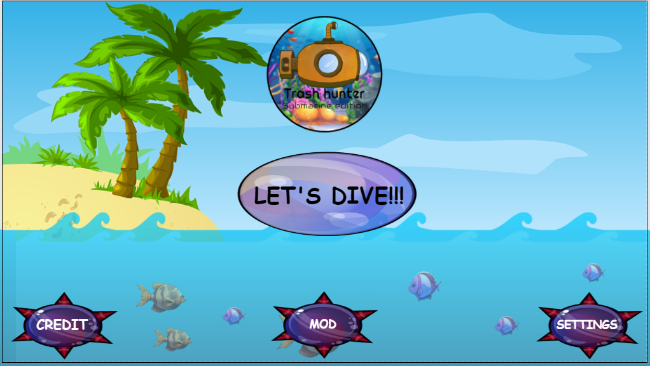
START SCREEN
The start screen of "Trash Hunter: Submarine Edition" is a comprehensive hub designed for easy navigation and player engagement. Featuring prominent buttons like "Play," "Credits," and "Settings," alongside a dedicated "MOD" section, the start screen offers players a versatile and accessible entry point into the game.

Slide 47
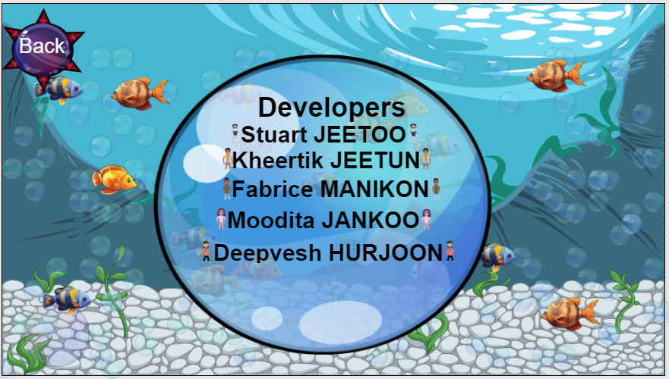
CREDIT SCREEN
The credit screen in "Trash Hunter: Submarine Edition" serves as a tribute to the individuals who contributed their skills and creativity to bring the game to life. This section acknowledges the developers whose collective efforts shaped the immersive gaming experience.

Slide 48
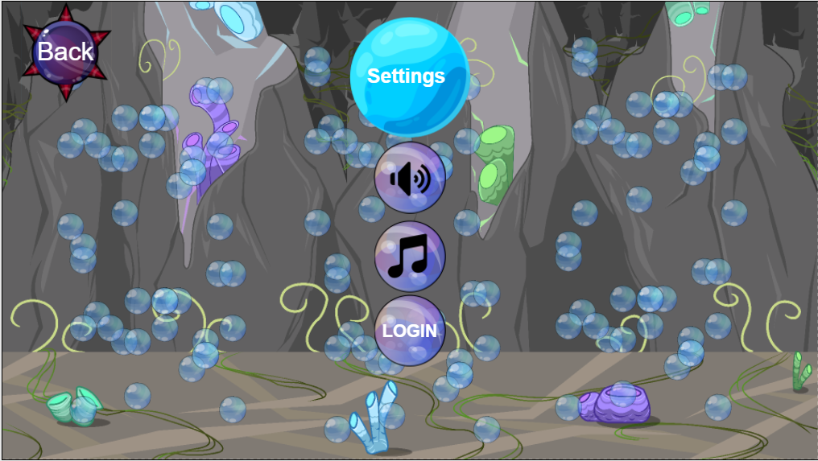
SETTINGS SCREEN
The settings screen in "Trash Hunter: Submarine Edition" offers players a trio of customizable options, including sound settings for an immersive experience, music controls to set the tone, and a login feature for personalization and community engagement. This user-friendly interface ensures that players can tailor their gaming experience to their preferences, enhancing overall enjoyment and engagement with the game.

Slide 49
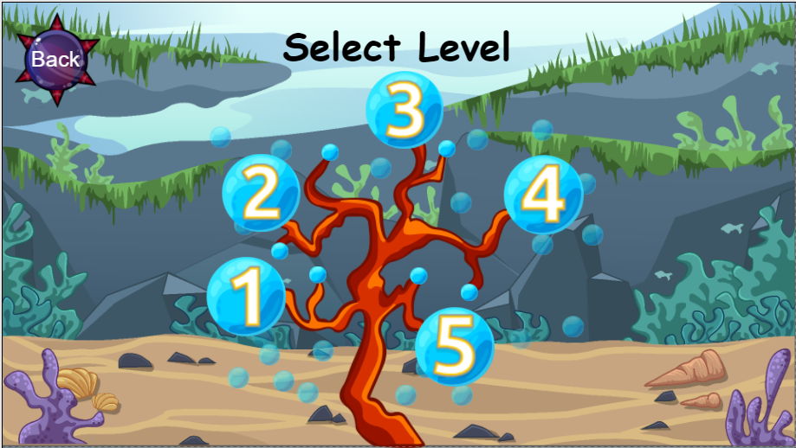
SELECT LEVEL SCREEN
The Select Level screen unfolds as a visually captivating and intuitively designed interface. Featuring five distinct levels, the creative UI not only serves as a gateway to diverse gaming experiences but also enhances the overall aesthetic appeal.

Slide 50
MOBILE UI

Slide 51
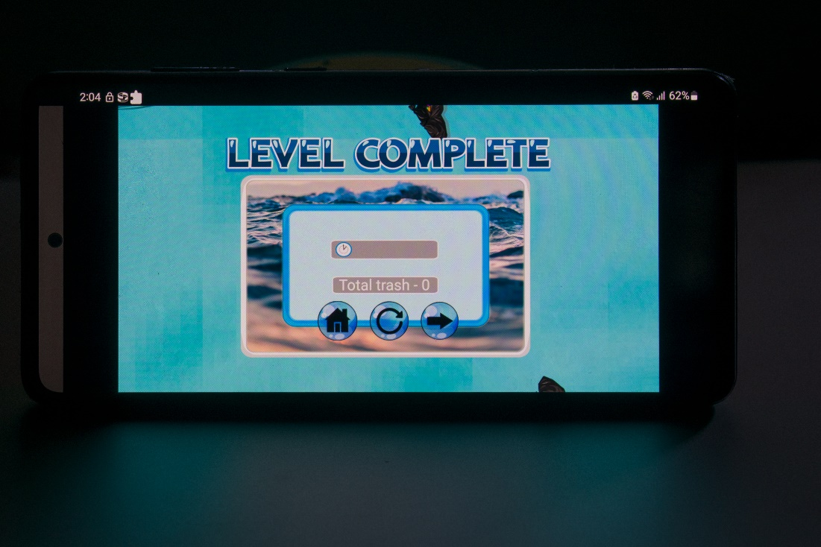
LEVEL COMPLETE UI

Slide 52
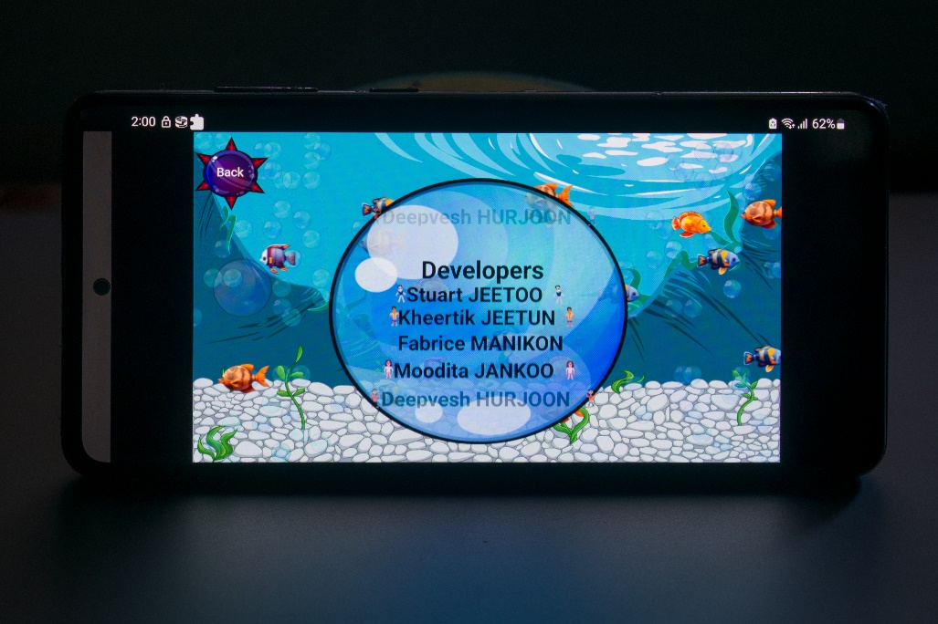
CREDIT SCREEN UI

Slide 53
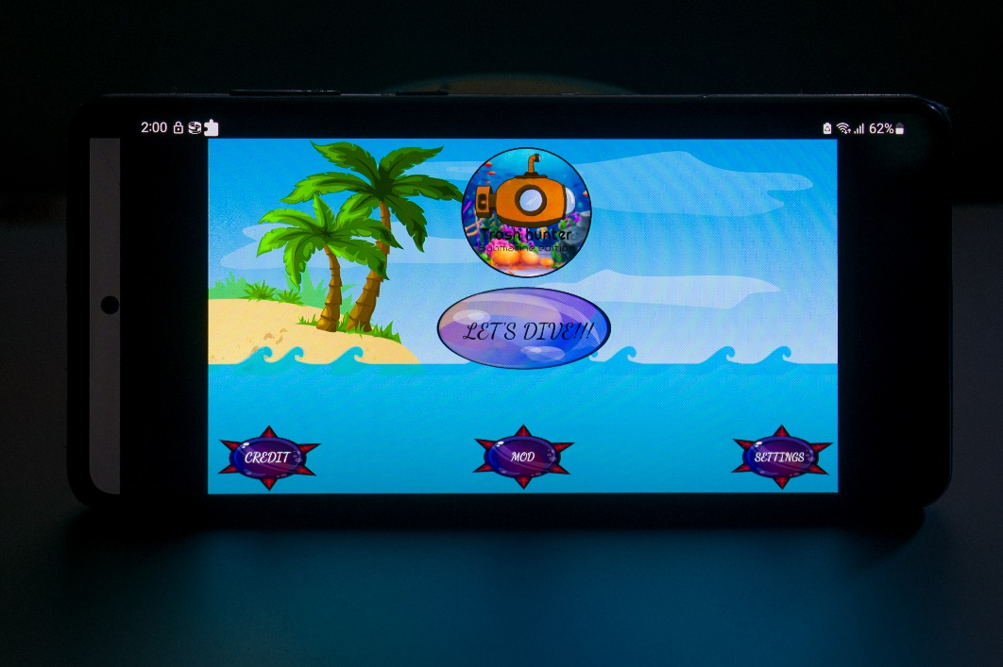
START SCREEN UI

Slide 54
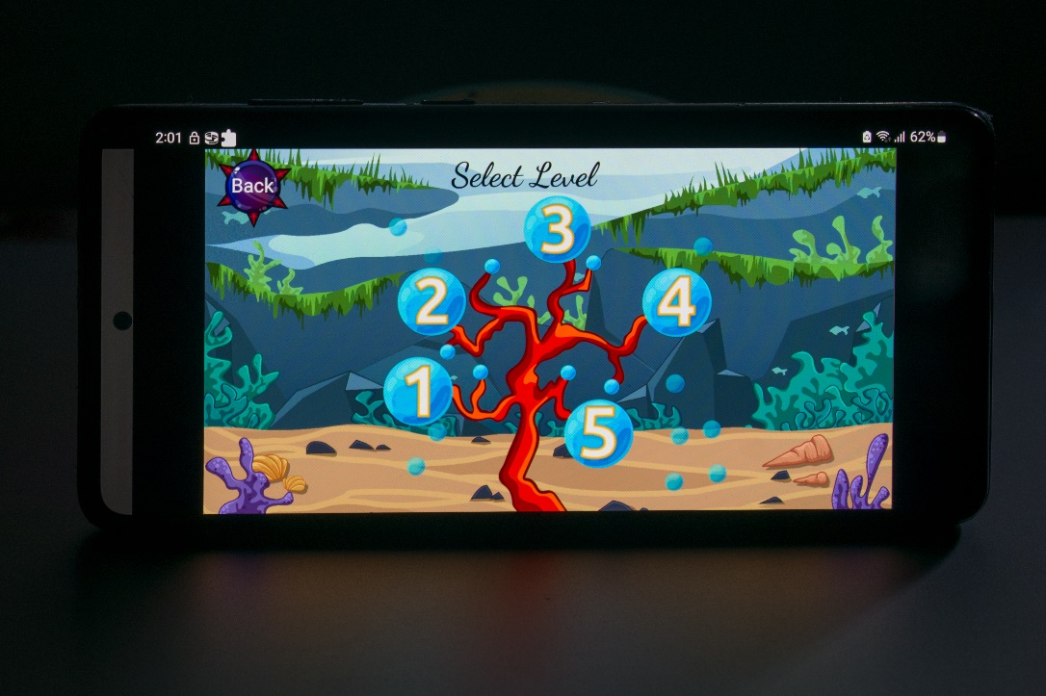
SELECT LEVEL SCREEN UI

Slide 55
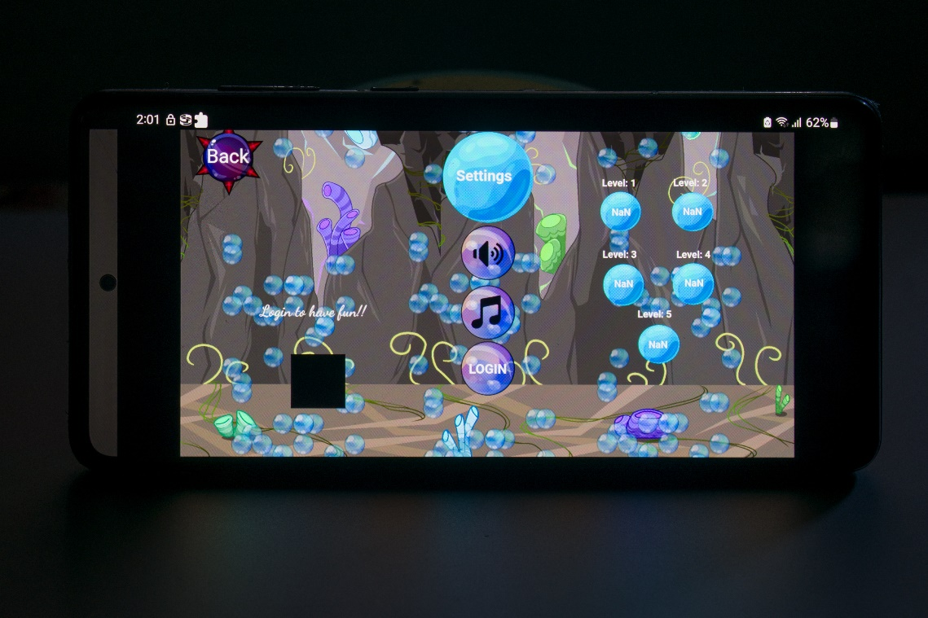
SETTINGS SCREEN UI

Slide 56
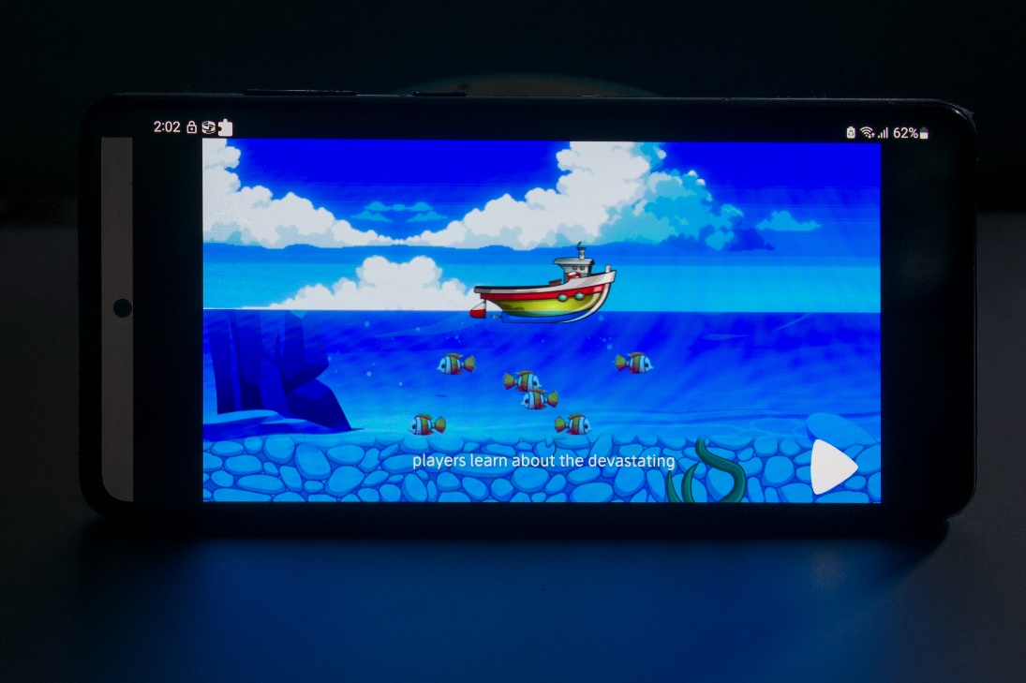
STORY TIME UI

Slide 57
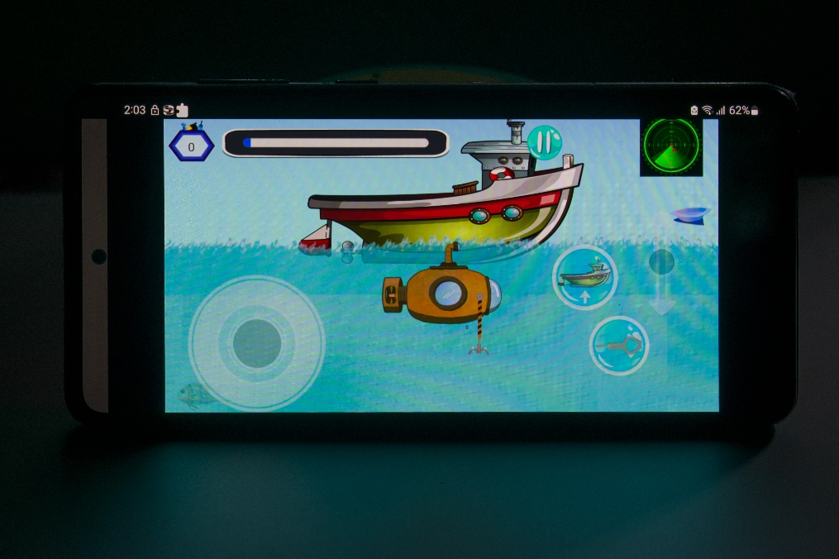
LEVEL UI

Slide 58
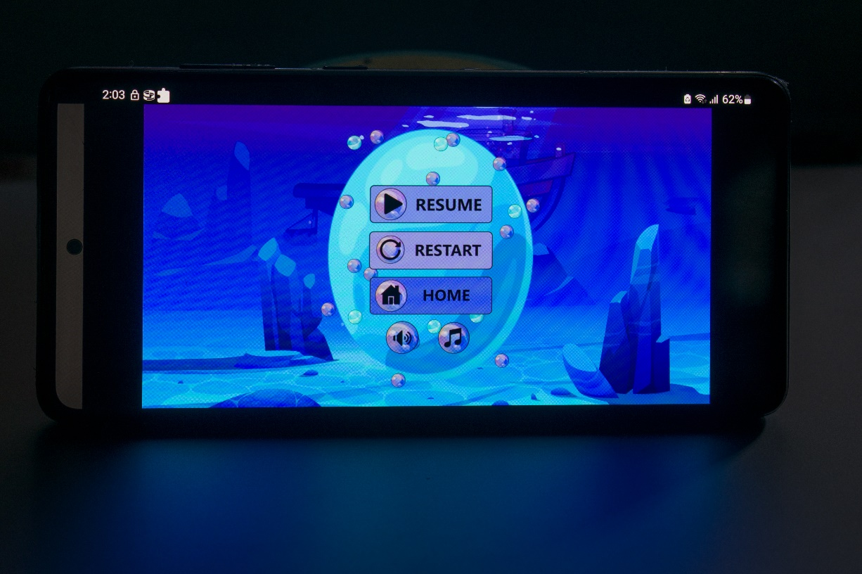
PAUSE SCREEN UI

Slide 59


Thank you!

